Slide 1

K-Means clustering algorithm
July, 2018

Slide 2
What is K-Means clustering?
How K- means algorithm works
Choosing number of clusters
Understanding K-Means(Step by Step)

Slide 3
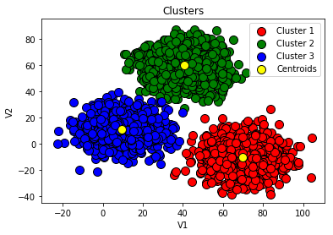
What is K-Means clustering?
K-means clustering is a type of unsupervised learning, which is used when you have unlabeled data (i.e., data without defined categories or groups). The goal of this algorithm is to find groups or clusters in the data, with the number of groups represented by the variable K.

Slide 4
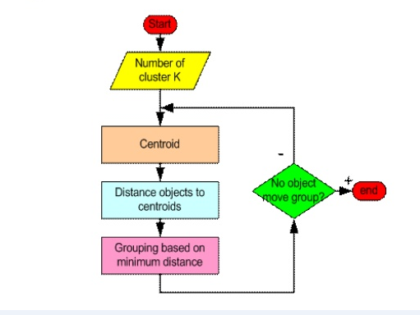
How k- means algorithm works?
STEP 1: Pick K random points as cluster centers called centroids.
STEP 2: Assign each xi to nearest cluster by calculating its distance to each centroid.
STEP 3: Find new cluster center by taking the average of the assigned points
STEP 4: Repeat Step 2 and 3 until none of the cluster assignments change.

Slide 5
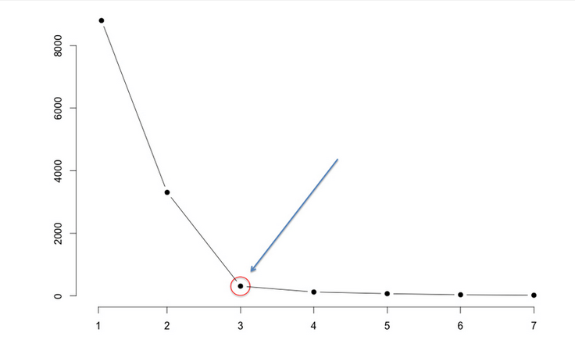
Choosing number of clusters
We run the algorithm for different values of K(say K = 10 to 1) and plot the K values against WCSS(Within Cluster sum of Squares). And select the value of K for the elbow point as shown in the figure
Links: https://mubaris.com/2017/10/01/kmeans-clustering-in-python/

Slide 6
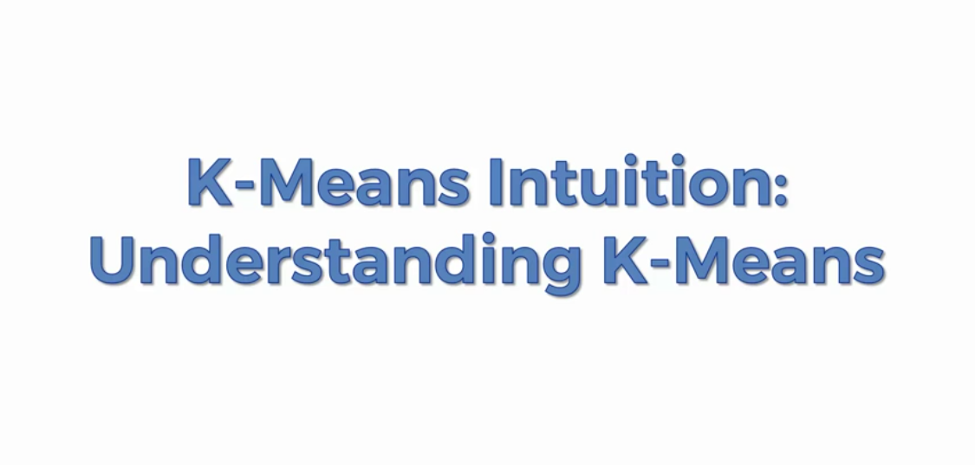
K-Means Clustering

Slide 7
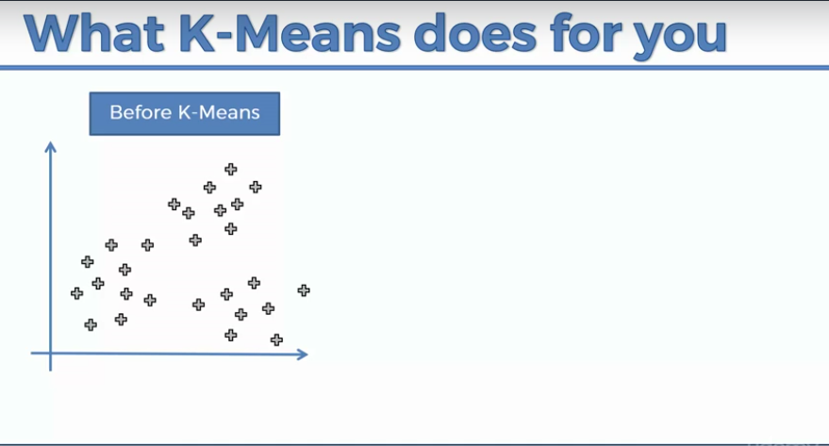
K-Means Clustering
Let’s say we have two variables in our dataset and we have plotted a scatterplot of these variables on x and y axis as shown below.

Slide 8
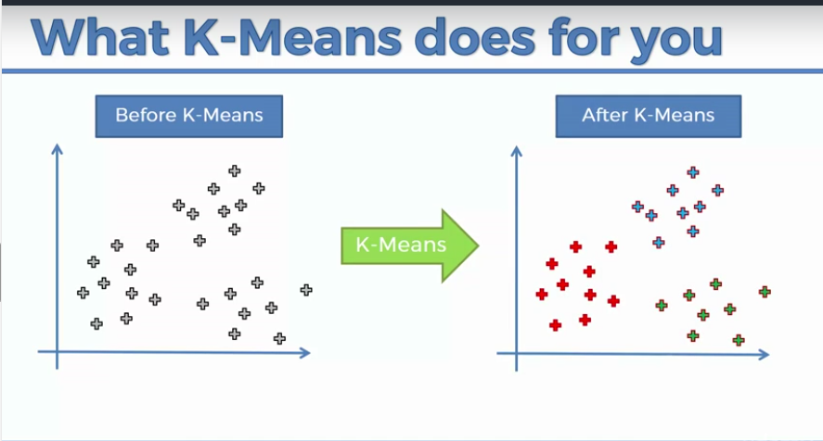
K-Means Clustering

Slide 9
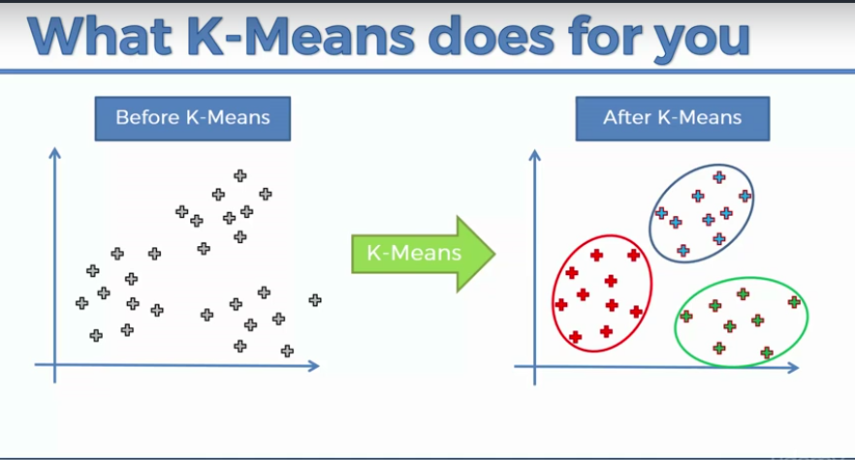
K-Means Clustering

Slide 10
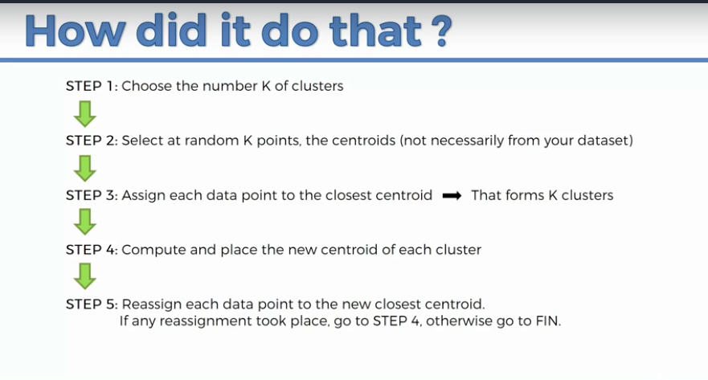
K-Means Clustering

Slide 11
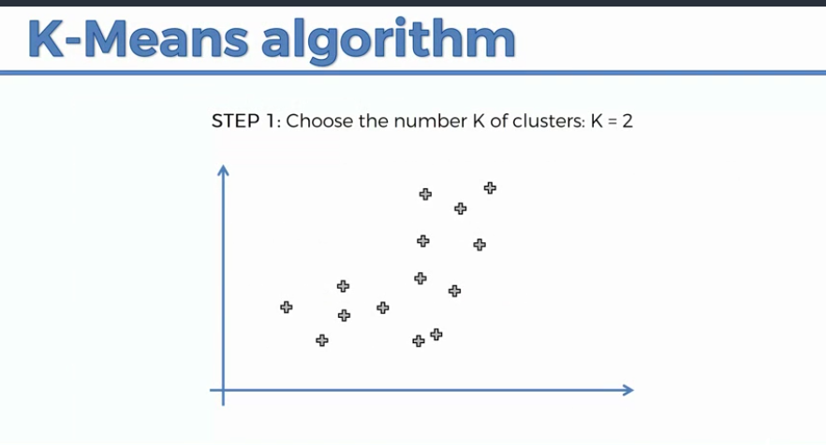
K-Means Clustering

Slide 12
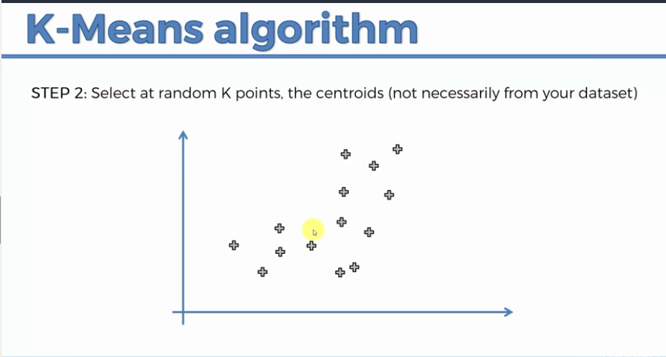
K-Means Clustering

Slide 13
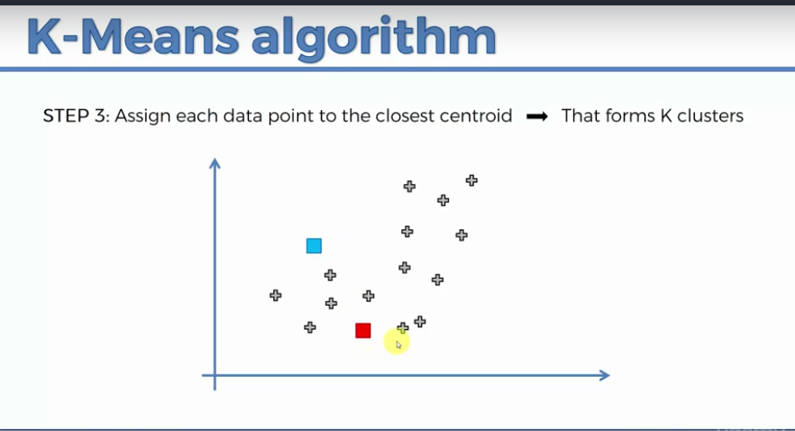
K-Means Clustering

Slide 14
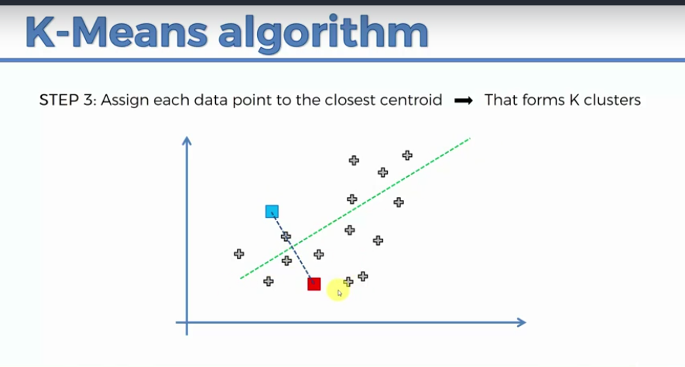
K-Means Clustering

Slide 15
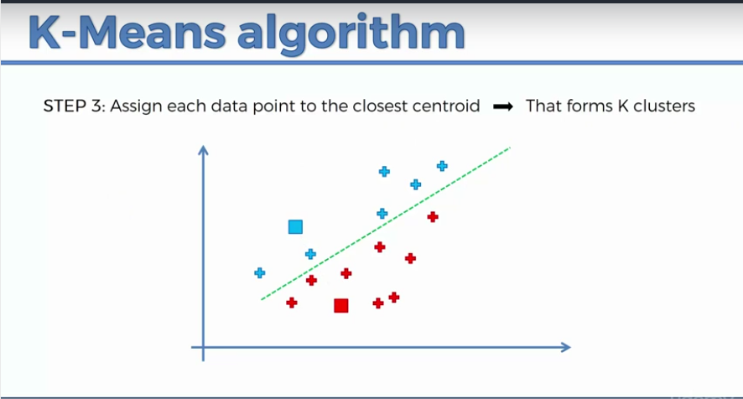
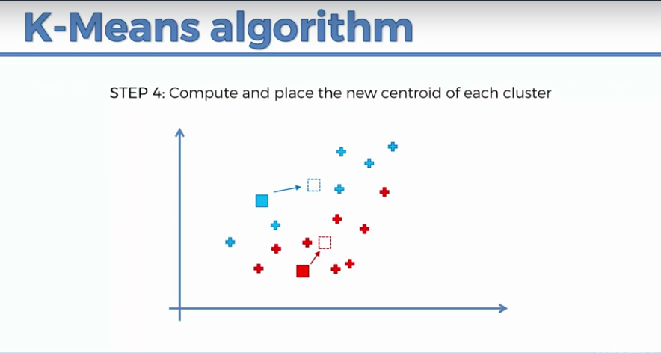
K-Means Clustering

Slide 16
K-Means Clustering

Slide 17
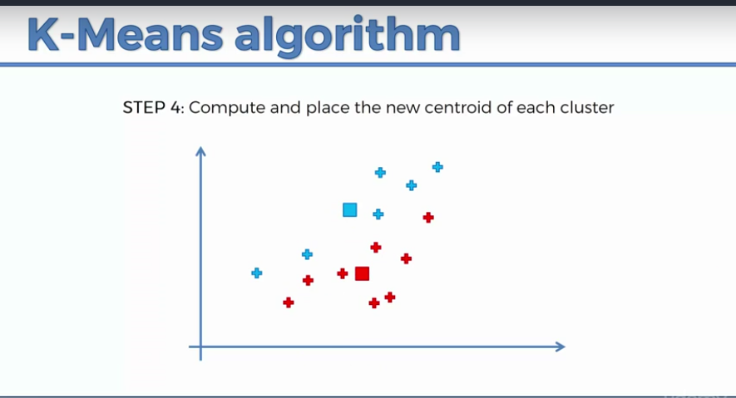
K-Means Clustering

Slide 18
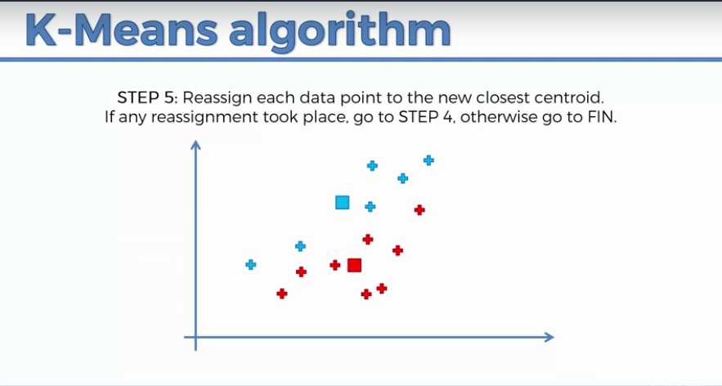
K-Means Clustering

Slide 19
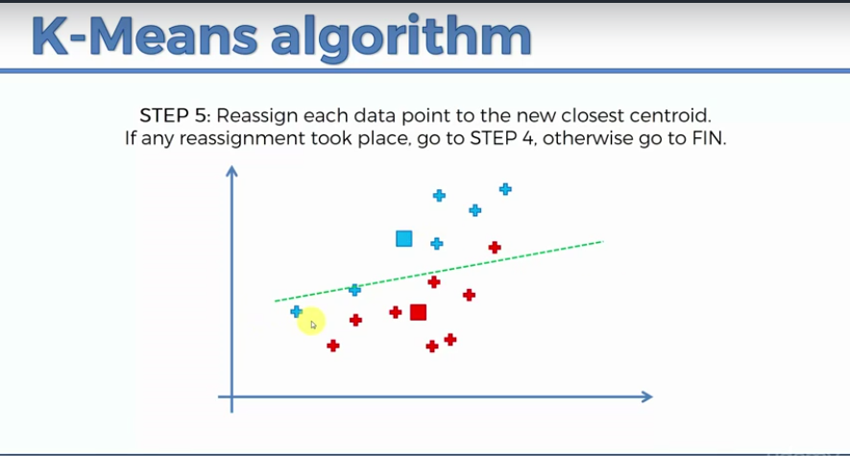
K-Means Clustering

Slide 20
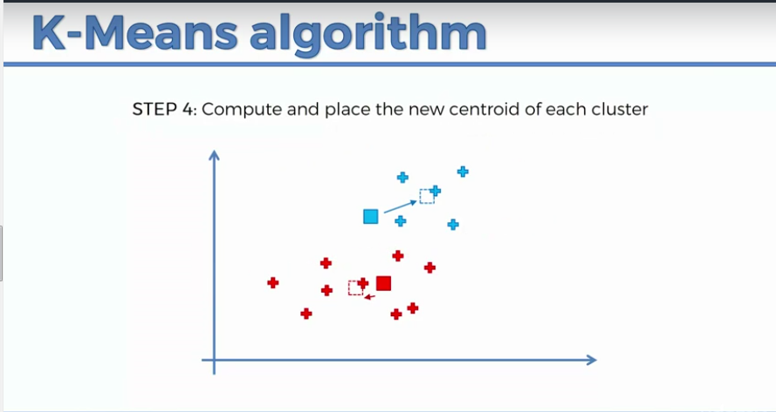
K-Means Clustering

Slide 21
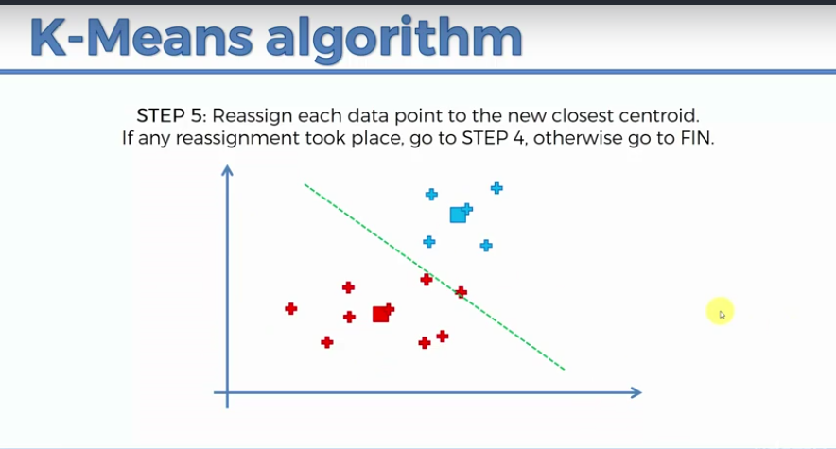
K-Means Clustering

Slide 22
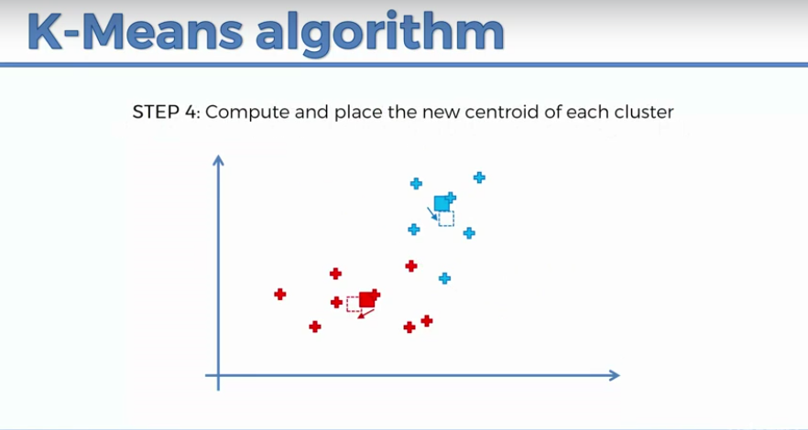
K-Means Clustering

Slide 23
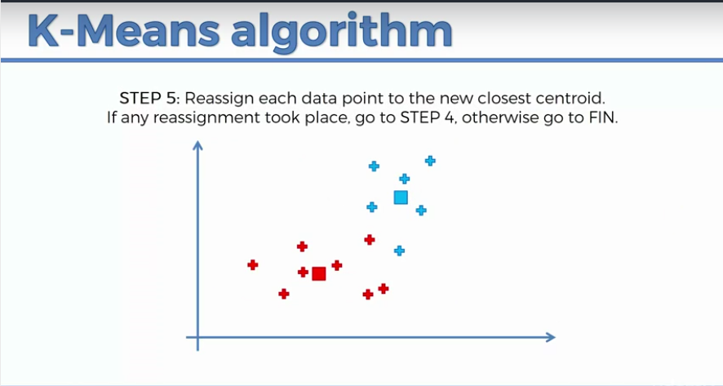
K-Means Clustering

Slide 24
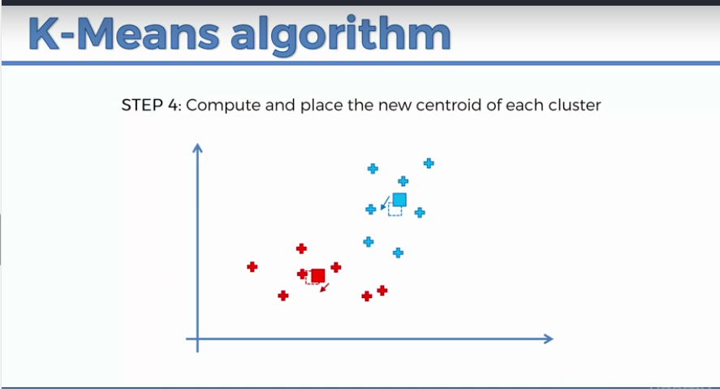
K-Means Clustering

Slide 25

K-Means Clustering

Slide 26
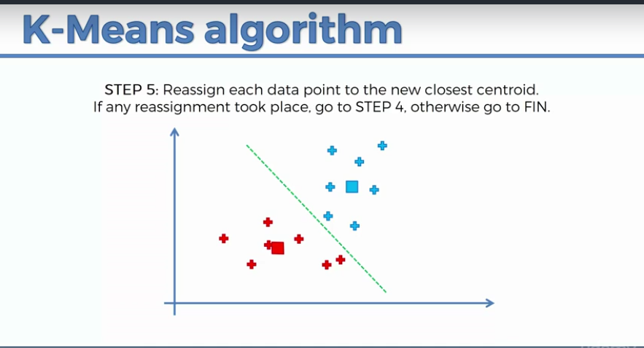
K-Means Clustering

Slide 27
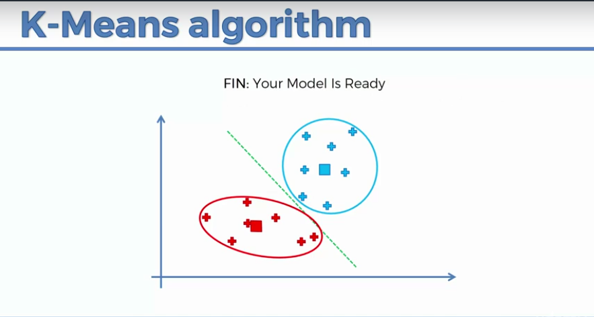
K-Means Clustering

Slide 28
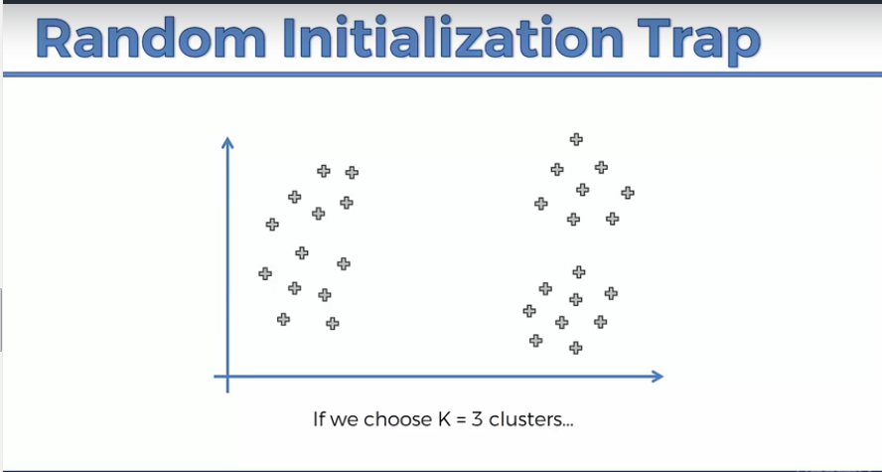
K-Means Clustering

Slide 29
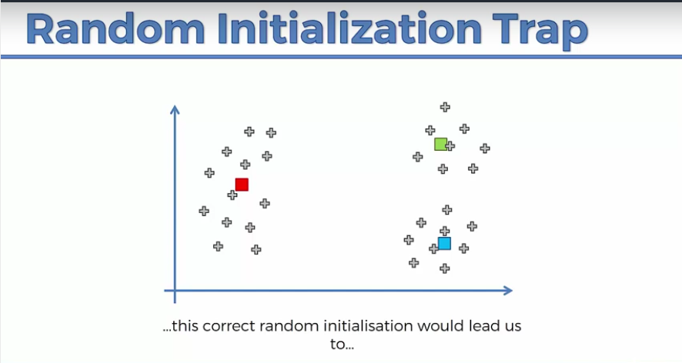
K-Means Clustering

Slide 30
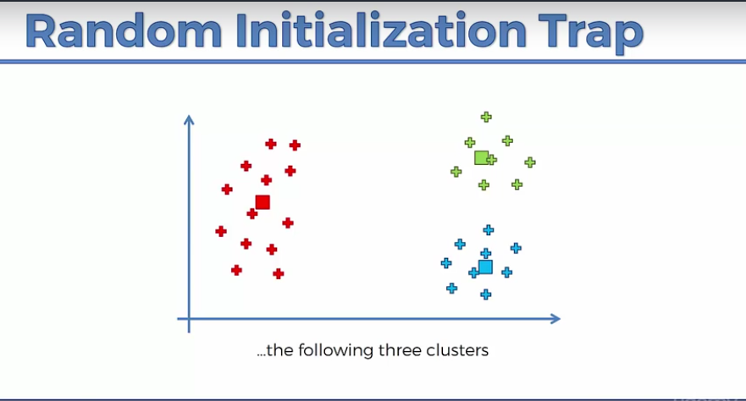
K-Means Clustering

Slide 31
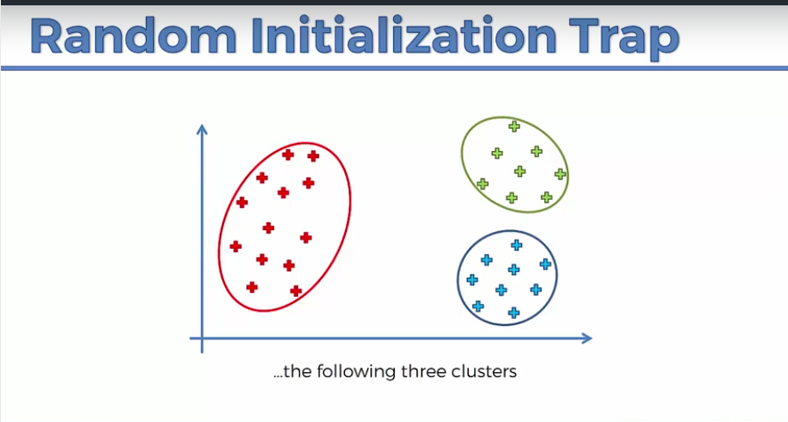
K-Means Clustering

Slide 32
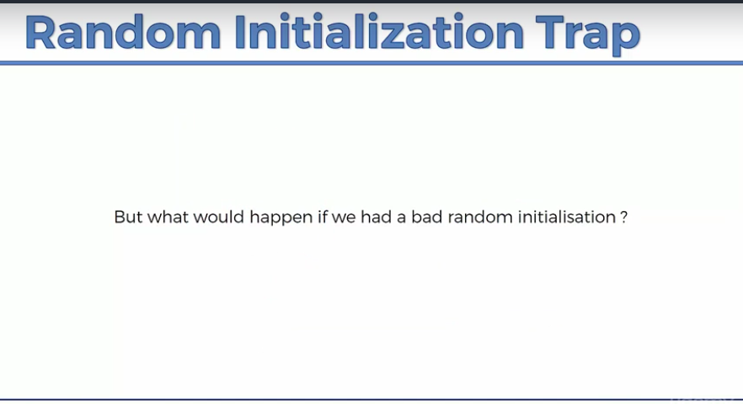
K-Means Clustering

Slide 33
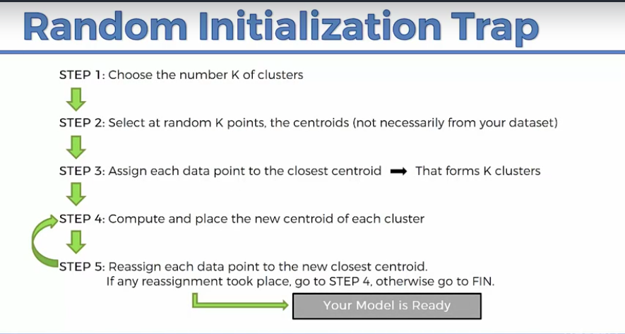
K-Means Clustering

Slide 34
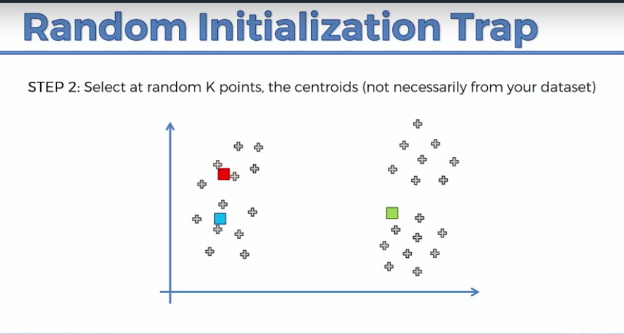
K-Means Clustering

Slide 35
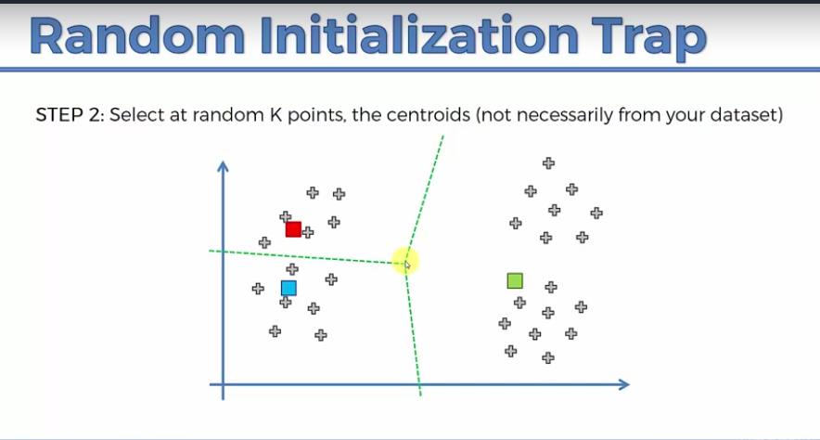
K-Means Clustering

Slide 36
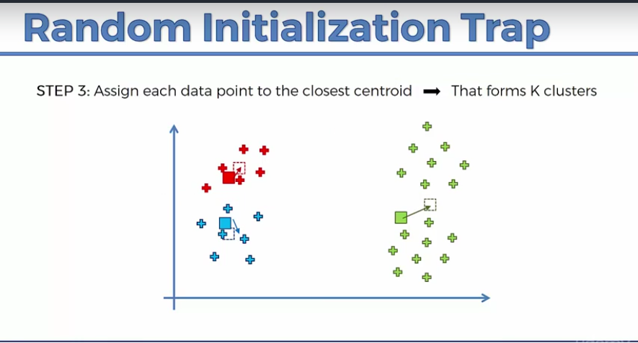
K-Means Clustering

Slide 37
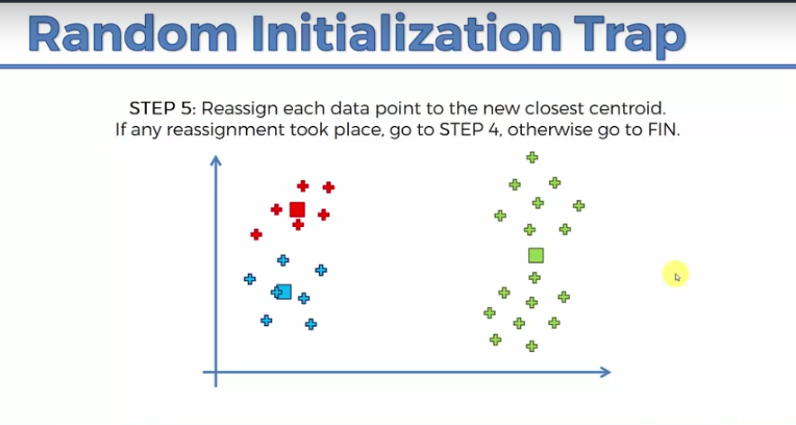
K-Means Clustering

Slide 38
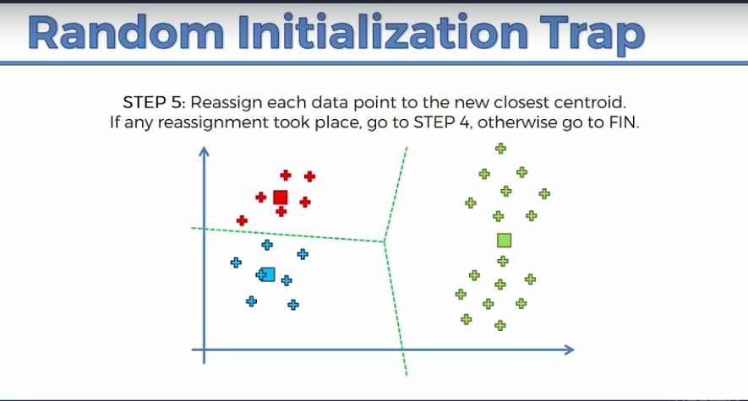
K-Means Clustering

Slide 39
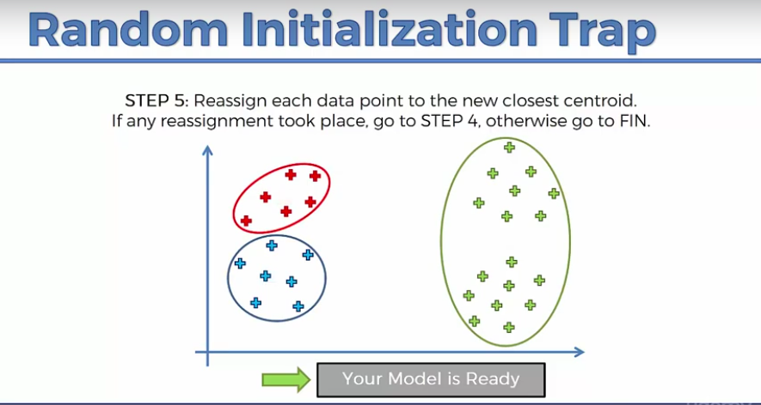
K-Means Clustering

Slide 40
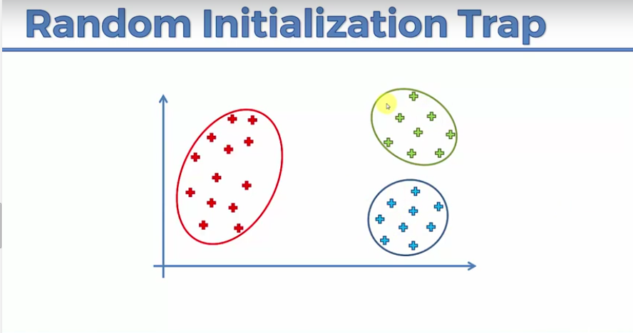
K-Means Clustering

Slide 41
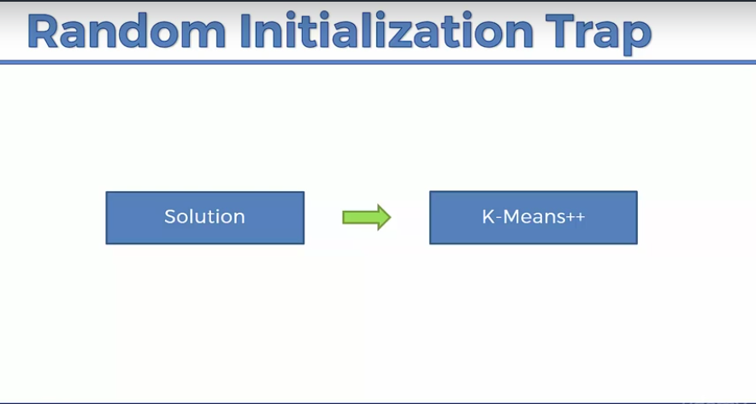
K-Means Clustering

Slide 42
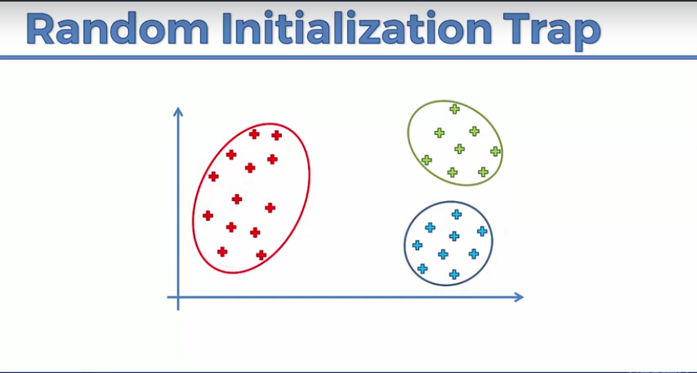
K-Means Clustering

Slide 43
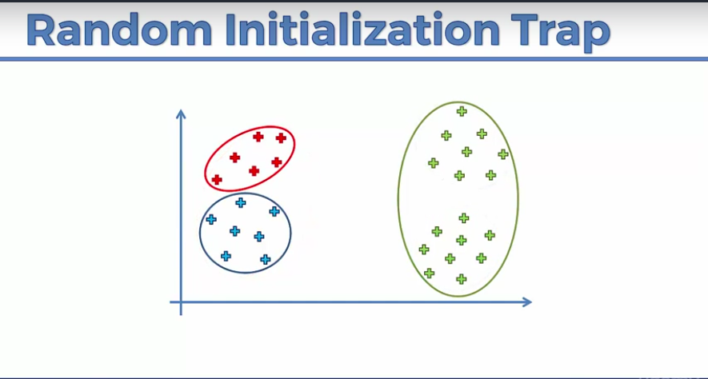
K-Means Clustering

Slide 44
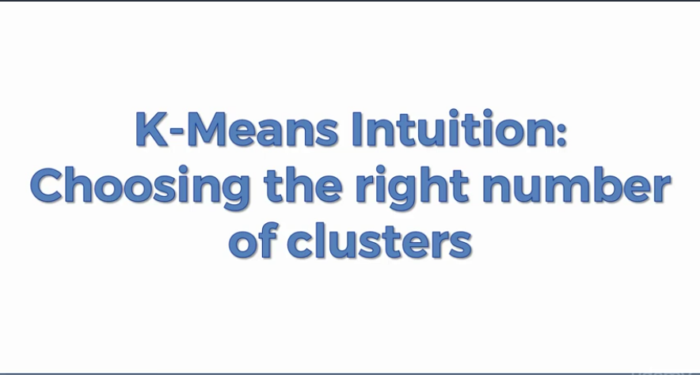
K-Means Clustering

Slide 45
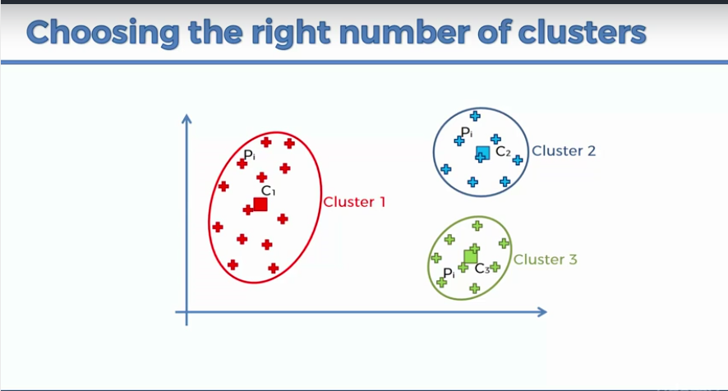
K-Means Clustering

Slide 46
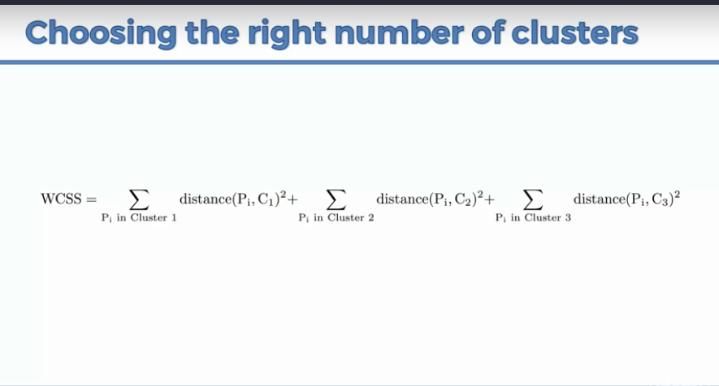
K-Means Clustering
WCSS = Within Cluster Sum of Squares

Slide 47
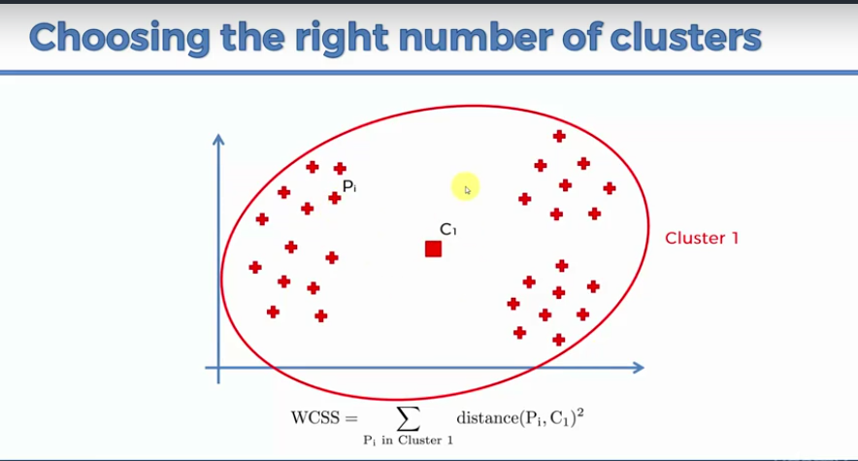
K-Means Clustering

Slide 48
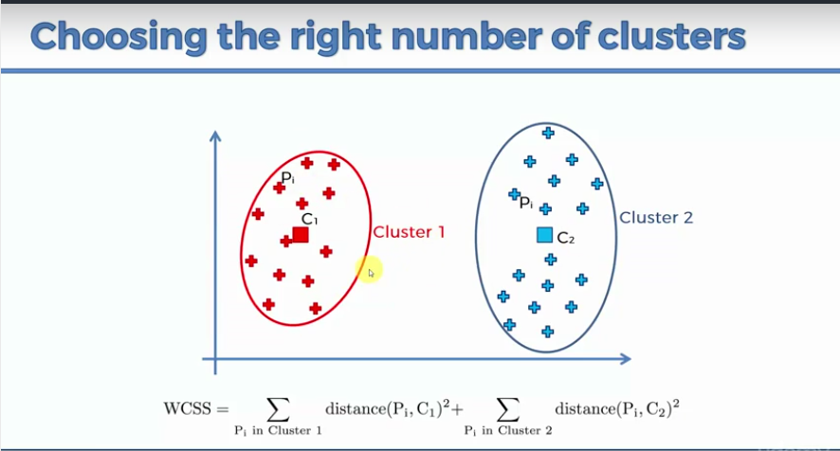
K-Means Clustering

Slide 49
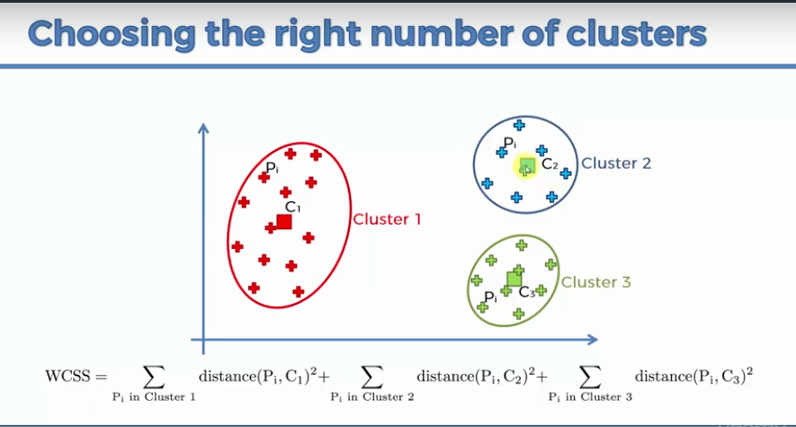
K-Means Clustering

Slide 50
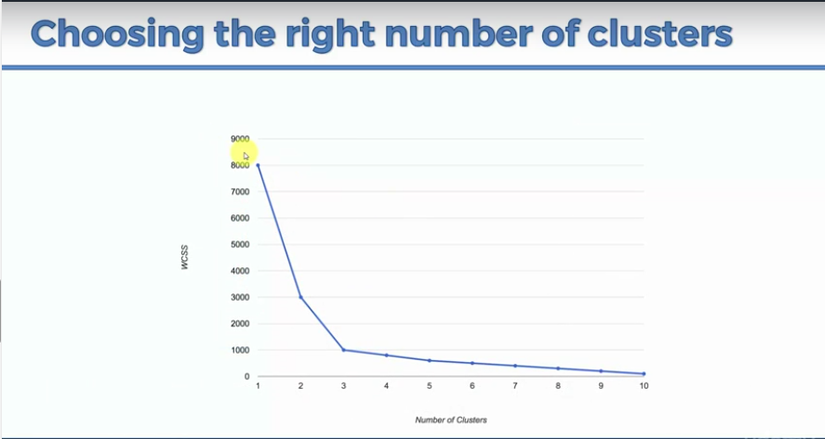
K-Means Clustering

Slide 51
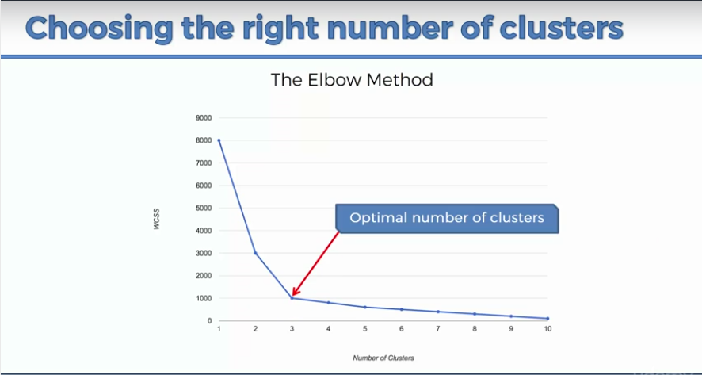
K-Means Clustering

Slide 52
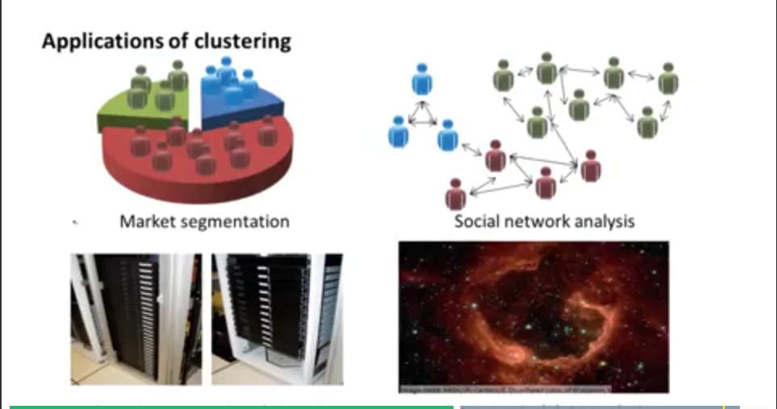
K-Means Clustering

Slide 53
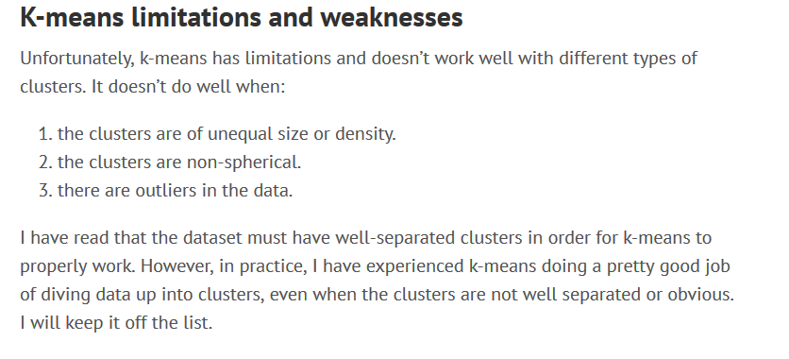
K-Means Clustering

Slide 54

K-Means Clustering

Slide 55

K-Means Clustering

Slide 56

K-Means Clustering

Slide 57

K-Means Clustering
For non spherical data like shown above in picture we can use techniques like:
Spectral Clustering
DBSCAN Clustering
Single Linkage

Slide 58

Difference Between K-Nearest Neighbors and K means
K-Means Clustering
K-nearest neighbors is a classification algorithm, which is a subset of supervised learning. In a KNN algorithm, a test sample is given as the class of majority of its nearest neighbors. In plain words, if you are similar to your neighbors, then you are one of them.

Slide 59

K-Means Clustering
K-means is a clustering algorithm, which is a subset of unsupervised learning.

